Slide 1

2022
Multilevel Intervention Training Institute
January 20, 2022

Slide 2

Introduction and Welcome
Paul Jacobsen, Ph.D.
National Cancer Institute

Slide 3

Programmatic perspective of
Multilevel Interventions
Sarah Kobrin, PhD
National Cancer Institute

Slide 4
The Context of Healthcare Delivery
Why NCI is supporting training on multilevel methods and interventions
Sarah Kobrin, PhD., M.P.H.
January 20, 2022

Slide 5
Modern healthcare is delivered to patients and families by physicians and clinical teams, in clinics, in buildings, in organizations.
Understanding this context of healthcare is essential to improving healthcare outcomes for all.

Slide 6
Cancer control research occurs in diverse settings
Cancer prevention and control interventions have been tested in settings that influence views of cancer screening, diet, exercise, smoking, vaccination.
Health behavior interventions designed to change individual behavior are more effective in settings where:
    Participants felt comfortable, such as at home; or,
    A leader’s endorsement could be influential, such as at church; or,
    Peers’ approbation could be heard and followed, such as a barber shop or other social gathering spot.
Interventions designed to be effective in health services:
    Focus on meaningful patient care outcomes across multiple settings;
    Concentrate on describing processes of care and measuring patient outcomes.
Merging what we know from these disciplines provides a structure for approaching complex, multilevel interventions in real world settings.
Notes:
Cancer prevention and control takes place in many settings – community centers, at home, churches, barber shops, and, of course, a wide variety of healthcare settings.
We can divide progress into two categories of interventions:
1) Health behavior interventions which are designed to change individual behavior and are more effective in settings where: participants felt comfortable, such as at home; or, a leader’s endorsement could be influential, such as at church; or, peers’ approbation could be heard and followed, such as a barber shop or other social gathering spot.
2) Interventions designed to influence health services: Focus on meaningful patient care outcomes across multiple settings; Focus on describing processes of care and measuring patient outcomes
Merging what we know from these disciplines provides a structure for approaching complex, multilevel interventions in real world settings.
PDR: Not sure you need this sentence: Tremendous advances have been made in teasing apart the many processes that constitute “healthcare” and in measuring impacts of various health processes on outcomes – as reported by doctors and by patients.

Slide 7
Merging Perspectives
More successful interventions to improve cancer prevention and control
Increasingly the two perspectives – behavioral interventions and observations of healthcare processes – are merging.
  Intervention context can be understood and measured with detail – and across levels – beyond capitalizing on an opinion leader or comfortable setting.
  Observational health services can describe care pathways with a finer focus on modifiable characteristics.
Models from Implementation Science link the complexity of healthcare contexts to the success of evidence-based interventions.
Increasing the sophistication with which we conceptualize, measure, and intervene on the interplay across characteristics of healthcare settings, should improve care delivery.
Notes:
(e.g., Consolidated Framework for Implementation Research, CFIR, Damschroder et al., 2009).

Slide 8
Crucial gaps are stalling research
Settings influence every step of care, yet tools are limited
Describe characteristics of healthcare delivery settings
    we need constructs and measures that facilitate both local description and cross-system comparison;
Link those characteristics to outcomes
    we need conceptual models to describe how the constructs affect each other lead to the outcomes;
Develop setting-changing interventions
    we need to develop interventions that can improve care quality.
Notes:
While we are making progress, we are not there. There are crucial gaps stalling our research including
Describe characteristics of healthcare delivery settings we need constructs and measures that facilitate both local description and cross-system comparison;
Link those characteristics to outcomes we need conceptual models to describe how the constructs affect each other lead to the outcomes;
Develop setting-changing interventions we need to develop interventions that can improve care quality.
The multilevel intervention training institute (MLTI) will help you understand how to develop interventions that translate into meaningful patient outcomes across multiple context.
We want you let you know that NCI strongly supports this training which we hope will result in you absorbing new knowledge that can be transferred to successful cancer control grants.

Slide 9
www.cancer.gov
www.cancer.gov/espanol
Notes:
We are thrilled to welcome you and want you to know that NCI strongly supports this important training. We hope the new knowledge you assort can be transferred to successful future cancer control grants.

Slide 10

Current attention to multilevel research
Erica S. Breslau, Ph.D.
National Cancer Institute

Slide 11

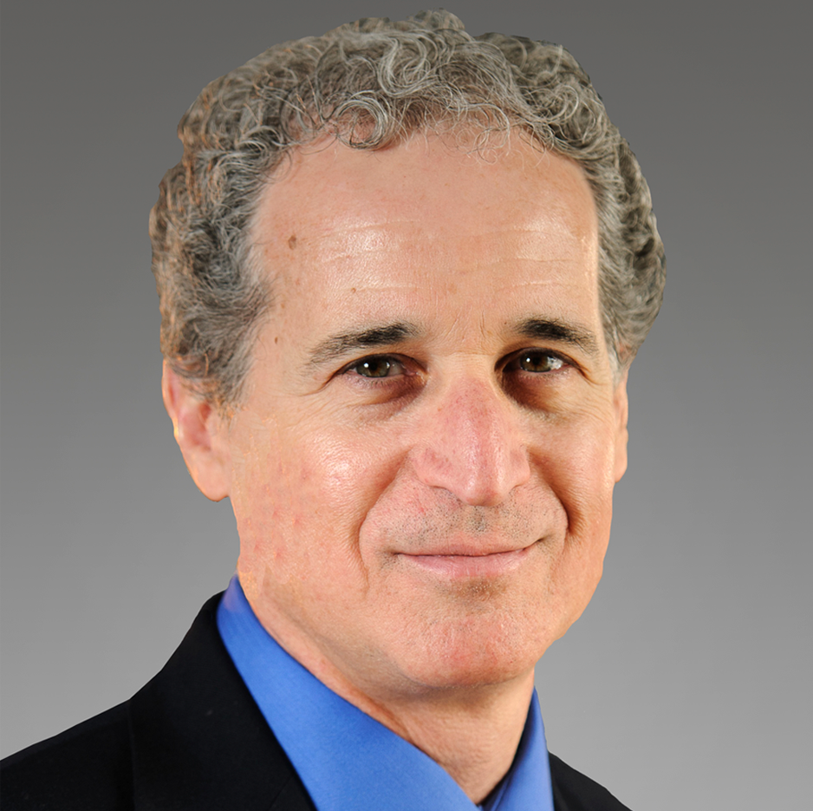

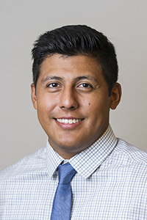
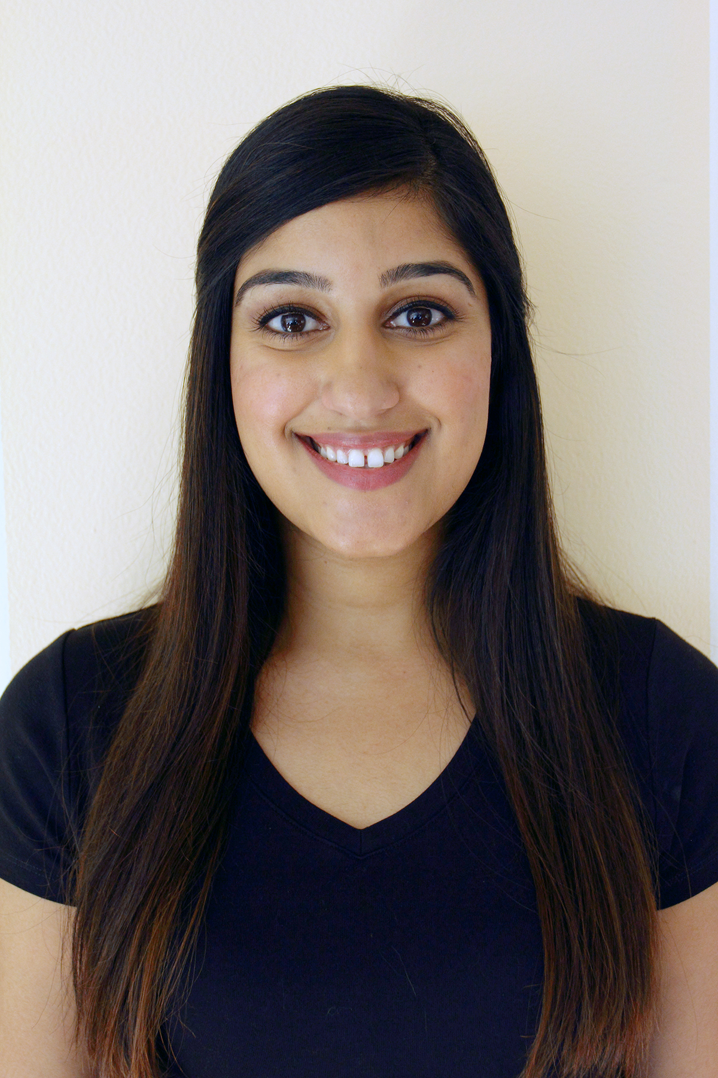
Your MLTI Team
Erica S. Breslau
Brian S. Mittman
National Cancer Institute
Kaiser Permanente
Joshua Medel
Bhanuja Dub
National Cancer Institute
Kaiser Permanente

Slide 12
History of Multilevel Intervention Research
Scholars across a wide array of disciplines within the social sciences have made critical contributions to multilevel research.
Contributions were driven by the multilevel nature of the many research questions studied.
All agree that a strong foundation of theory, measurement, and analysis is critical.
Despite the rising prominence within social sciences, multilevel research is not without growing pains.
Humphrey, LeBreton, 2020

Slide 13





Sequential Approach to Multilevel Intervention Research
.
2011
2012
2012-2019
2019
2020+
JNCI Supplement
MLTI Curriculum
MLI 1.0
RFA/PA
MLTI 2.0
MLI conference
examined
MLI scientific
concepts
Collection
of
seminal
MLI articles
Seven funding
announcements
calling for
MLI methods
.
MLTI
curriculum development
Multilevel Intervention
Training
Institute

Slide 14

Definition
Interventions at two or more levels of individuals (patients, providers, caretaker) clinical teams, healthcare systems (organization), and/or community settings that measure outcomes at all levels.
Multilevel Interventions

Slide 15





After the Socioecological Model- The “Onion”
Healthcare System, Organization
Healthcare Clinic
Physicians, Clinical Team
Individuals
Community Setting
Community Setting: Environments in which the process of delivering healthcare reflects approaches followed by providers whose primary responsibilities are patient care ( e g, Federally Qualified Heath Centers.
Healthcare System, Organization: Collection of primary and specialty care providers and support staff, medical facilities and organizational structures connected to each other through common ownership or joint management.
Healthcare Clinic: Specific location where patients receive health care that is often defined by one type of care.
After the Socioecological Model- The “Onion”
Physicians, Clinical Team: Two or more providers including primary and specialty care and support staff who care for patients.
Individuals: Patients, caregivers, family members, providers.
Bronfenbrenner, 1979

Slide 16

Thank you

Slide 17

Scope of multilevel research in healthcare and public health
Brian S. Mittman, PhD
Kaiser Permanente Southern California

Slide 18
Why do we need MLIs?
Healthcare System, Organization
Healthcare Clinic
Physicians, Clinical Team
Individuals
Community Setting
Many of the most pressing problems in healthcare delivery and public health are caused by multiple factors at multiple levels
Chronic disease (mis)management
(patient self-management, MD G/L adherence, health system support, community support)
Disease prevention and screening (patient activation/adherence, MD endorsement, health system SOPs, community norms and support, regulatory support)
Patient safety (clinician/team practices, organizational policies/practices, professional community norms, regulatory factors)

Slide 19

Which questions should we answer?
Does it work? Is it “effective”?
  Should it be approved? Funded? Promoted? Mandated?
  Included in a registry of EBPs?
  Should we use it?

Slide 20

“Is the intervention Effective?”
How do we (researchers) often answer?
Do outcomes differ for those receiving the
intervention vs. not (or intervention A vs. B)?
Do selected features of intervention settings
and targets influence effects?
Gold standard method: randomize and measure
outcome differences; perform subgroup analyses
... or use other impact-focused designs
Focus is on impact

Slide 21

Are our answers useful?
Does it work? Is it “effective”?
  For some drugs, the answer is “Yes, for many/most patients” (but cf precision medicine)
  For robust MLIs (e.g., some health promotion programs, healthcare delivery innovations) the
  answer is “Yes, often enough”
  For most MLIs, the answer is
  “sometimes…it depends”

Slide 22
MLI trial results, scenario 1:
Strong effects, moderate variance
 | 18
 | 16
Number of Sites | 14
 | 12
 | 10
 | 8
 | 6
 | 4
 | 2
 |  | -25 | -20 | -15 | -10 | -5 | 0 | 5 | 10 | 15 | 20 | 25 | 30 | 35 | 40 | 45 | 50 | 55 | 60 | 65
 |  |  |  |  |  |  | Change in Adherence

Slide 23
MLI trial results, scenario 2:
Weak effects, high variance
 | 18
 | 16
Number of Sites | 14
 | 12
 | 10
 | 8
 | 6
 | 4
 | 2
 |  | -25 | -20 | -15 | -10 |  | -5 | 0 | 5 | 10 | 15 | 20 | 25 | 30 | 35 | 40 | 45 | 50 | 55 | 60 | 65
 |  |  |  |  |  |  |  | Change in Adherence

Slide 24
Support for practice: evidence vs. insights and guidance
Support for dichotomous approval or selection decisions (FDA, EBP registry, adoption):
  Is it effective? Does it work? Which is more effective?
Insights and guidance for practice:
  How does it work? Why? Where? When? For Whom?
  How can we enhance its effectiveness?

Slide 25
Policy/practice decision makers’ questions
How do I choose an appropriate program given my context?
How do I implement (deploy) the program to increase effectiveness?
How do I tailor the program to increase effectiveness (initially and over time)?
How do I modify and manage the setting to increase effectiveness (initially and over time)?
How, why, when and where does it work?
How can I make it work?

Slide 26
Support for policy/practice leaders: evidence vs. insights and guidance
Support for dichotomous decisions, selection decisions (FDA and formulary, treatment):
  Is it effective? Does it work? Which is more effective?
Insights and guidance for practice:
  How does it work? Why? Where? When? For Whom?
  How can we enhance its effectiveness?
Impact focus vs. process focus (mediators, moderators, mechanisms, adaptation, managing context)

Slide 27
Desired features of MLI research
Explicit use of theory at all levels; attention to interactions across levels
Development and use of explicit causal model
Attention to (identification of) intervention components’ core functions in addition to forms (activities/components)
Explicit study of mechanisms of effect (in addition to measurement of impacts)
Attention to heterogeneity of treatment effects
Attention to contextual influences
Allowance for, and explicit study of, tailoring and adaptation

Slide 28
Desired features of MLI research
Intervention/Study Feature | Multilevel Intervention Studies
Study aims | Assess intervention effectiveness; document mechanisms of effect
Primary outcomes | Multiple outcomes at two, three or more levels
Intervention targets | Multiple target groups
Intervention content | Multiple, multilevel intervention activities
Explicit causal model | Required
Explicit use of theory | Required, combining multiple theories, models, and/or frameworks that capture influence at multiple levels and interactions between levels
Distinguish core functions from forms; identify functions | Strongly recommended; required for PCORI funding applications
Intervention tailoring | Preferable to permit and study
Study design | Clustered, adaptative, other atypical designs often needed
Analysis of contextual influences | Recommended unless effects are not context-sensitive
Process evaluation and explicit study of mediators and mechanisms of effect | Strongly recommended; mandatory if intervention is not highly robust
Qualitative study of mechanisms of effect | Strongly recommended
Quantitative study of mechanisms of effect (e.g., mediation analysis) | Strongly recommended
Other applications of qualitative/mixed methods | Strongly recommended

Slide 29
Questions and Answers
12:40pm—12:45pm

Slide 30

Case Study 1:
Exemplary Case Studies of MLI Research (Single vs. multiple levels)
Karen Emmons, Ph.D.
Harvard T.H. Chan
School of Public Health

Slide 31




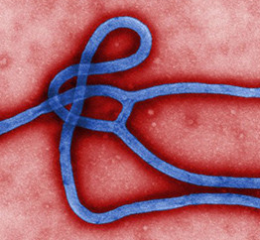


Case Study 1
Community-Focused Multilevel Interventions
Karen M. Emmons, Ph.D.
Multilevel Intervention Training Institute (MLTI)

Slide 32
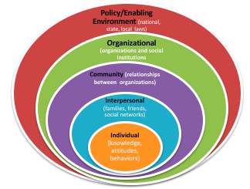
What is a community?
Functional spatial unit
Unit of patterned social interaction
Symbolic units of collective identity
Social unit for political change
  Two theoretical approaches:
  Ecological System Perspective
  Social Systems Perspective
Notes:
Some think of Community as “a unit of identity”, created through social interactions. Group of people sharing values and institutions (Thompson). Relevant irrespective of the major theoretical approach. What are some of the shared elements?
Membership has a sense of identity and belonging
Common symbol systems (e.g. language, rituals, ceremonies)
Shared values/norms
Offers mutual influence –members have influence over/ are influenced by each other
Shared needs and commitment to meeting them
Shared emotional connection – members share common hx, experience, support
Two theoretical approaches
(1) Ecological System Perspective: study of autonomous geographical communities; Focuses on pop characteristics (e.g. size, density, heterogeneity), phys , social, and techn environment; community development work is focused here
Ex: Organizing in Roxbury
(2) Social Systems Perspective: formal orgs that operate w/in a given community- interactions w/in comm subsystems (econ, political, etc).
reflecting communities as entities that change structure and functions to accommodate social, polit, econ developments
Not necessarily tied to geography
Ex: Focusing on affordable housing in black communities (e.g. MA Alliance of HUD tenants)
How one defines community will determine how you might approach community-level change

Slide 33
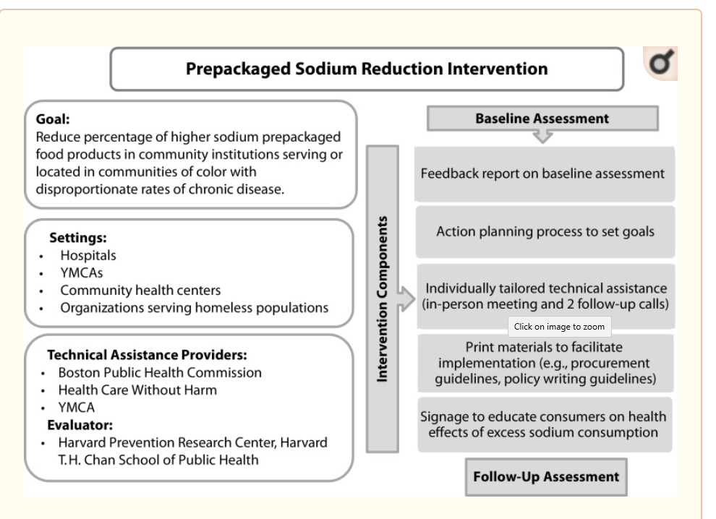
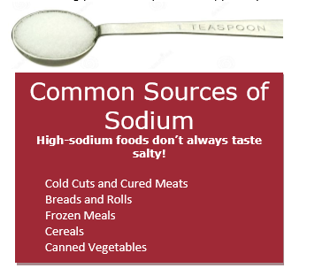

An Example of a (Single Level)
Community-Level Intervention
Brooks, et al., 2017
Notes:
Significant effect across orgs (7 % point change in high sodium/pre-packaged offerings) , on Hx cafeterias/kiosks (10% point change), and in YMCA vending (16% point change)

Slide 34
More Levels, More Impact… ??

Slide 35
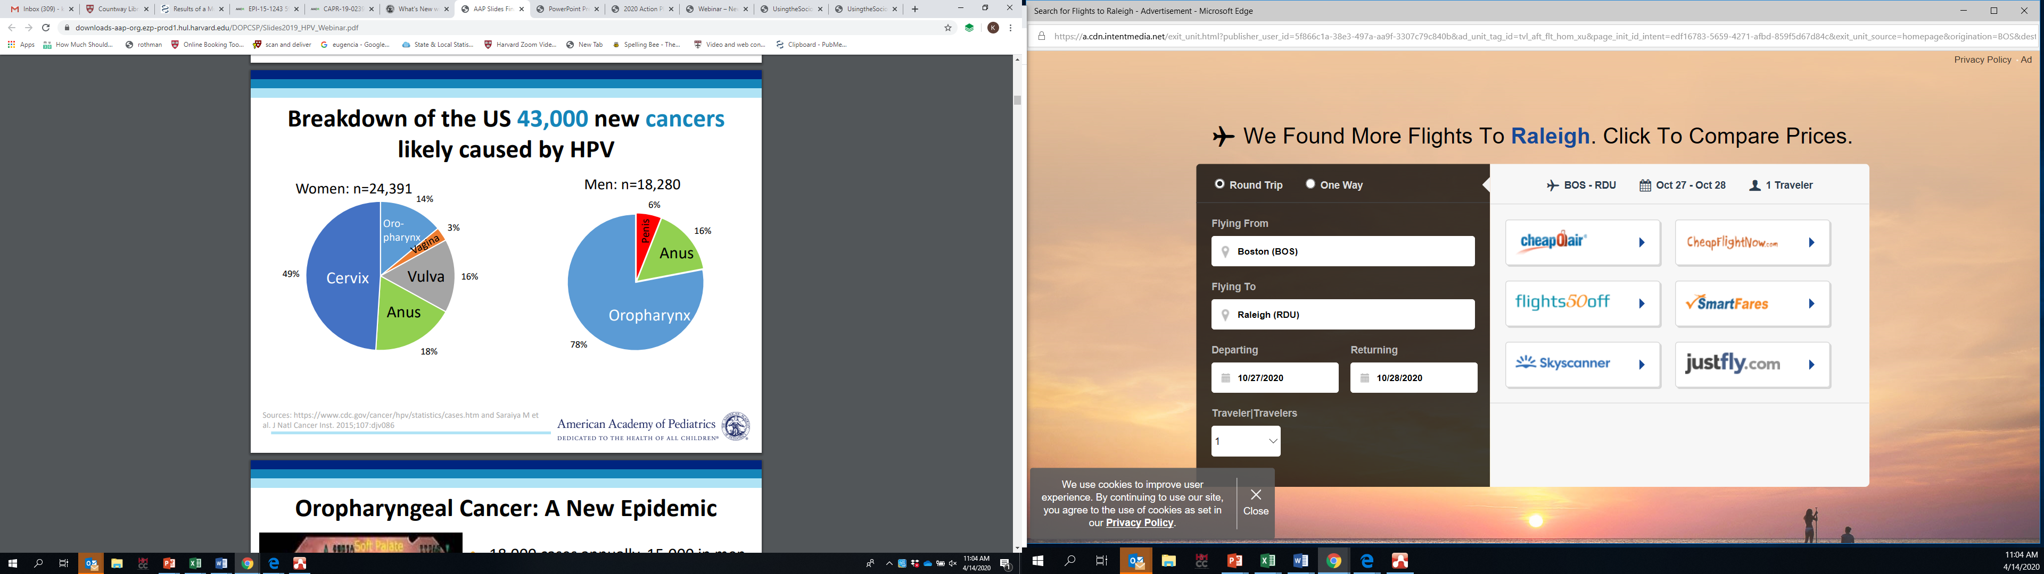
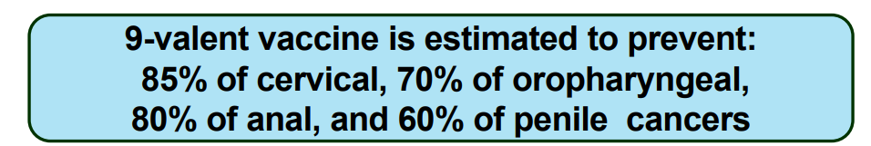
43,000 New Cancers Annually Caused by HPV
Notes:
Using HPV as case example
Will provide example of HPV– two studies that build on each other, using multi-level approaches– in community settings, but approaching the engagement with the community differently

Slide 36
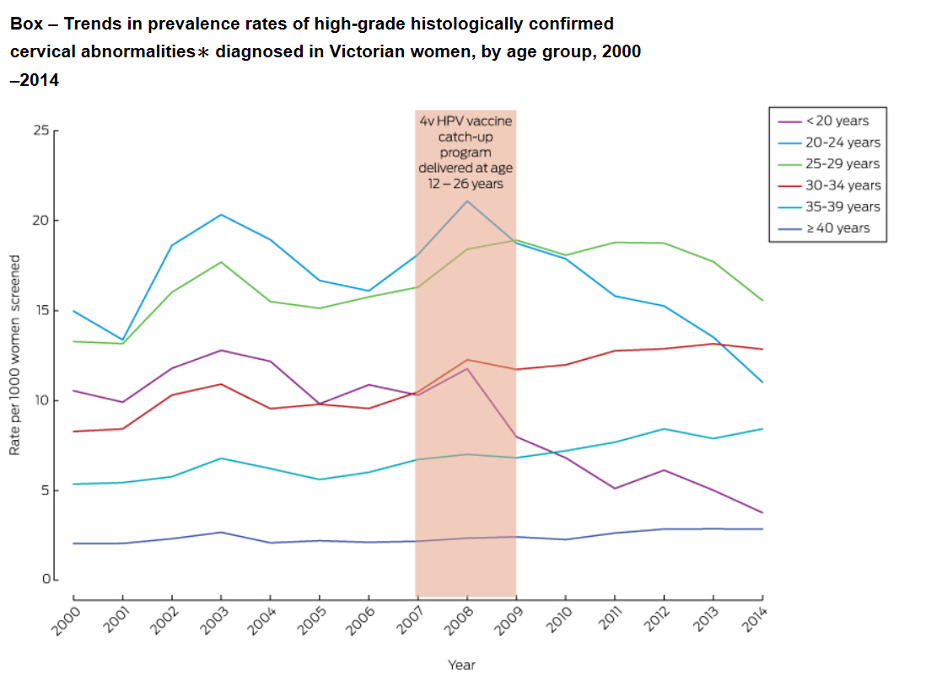
HPV Vaccination Will Likely Eradicate
Cervical Cancer in Australia
Mandatory school-based administration and free vaccine introduced in 2007
By 2015 (age 15):
  Girls: 83% had 2 doses
  77% had 3 doses
  Boys: 74% had 2 doses
        66% had 3 doses
National HPV Vaccination
Program Register, 2016
Notes:
Australian HPV experience– what can be accomplished with a MLI– government policy, school Ix, parental engagement
Had widespread intro of vaccine, including a mandatory school-based vaccination program in 2007; [uptake data]
Examined cervical lesions among girls and women up to age 29
After the widespread introduction of the vaccine, high-grade cervical abnormalities decreased significantly
from 2012 to 2014 incidence decreased by 17% among women 25-29, [GR and BL lines] w/ increasing incidence among women ages 35+
Rapid impact: Was a significant decrease in cervical abnormalities for those vaccinated within 5 years of program implementation.
Standardized mortality rate has dropped from 5.2 to 1.7 between 1982 and 2015
Will be a “rare disease”- (< 6/10,000 people) by 2022
Eradicated by 2038 (18 years)

Slide 37
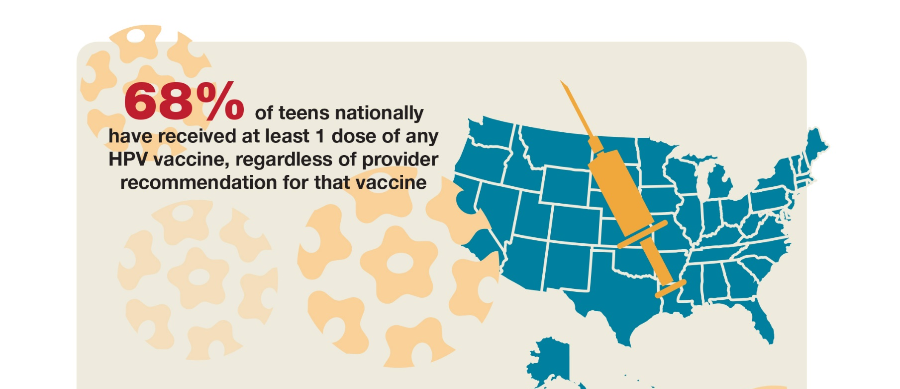
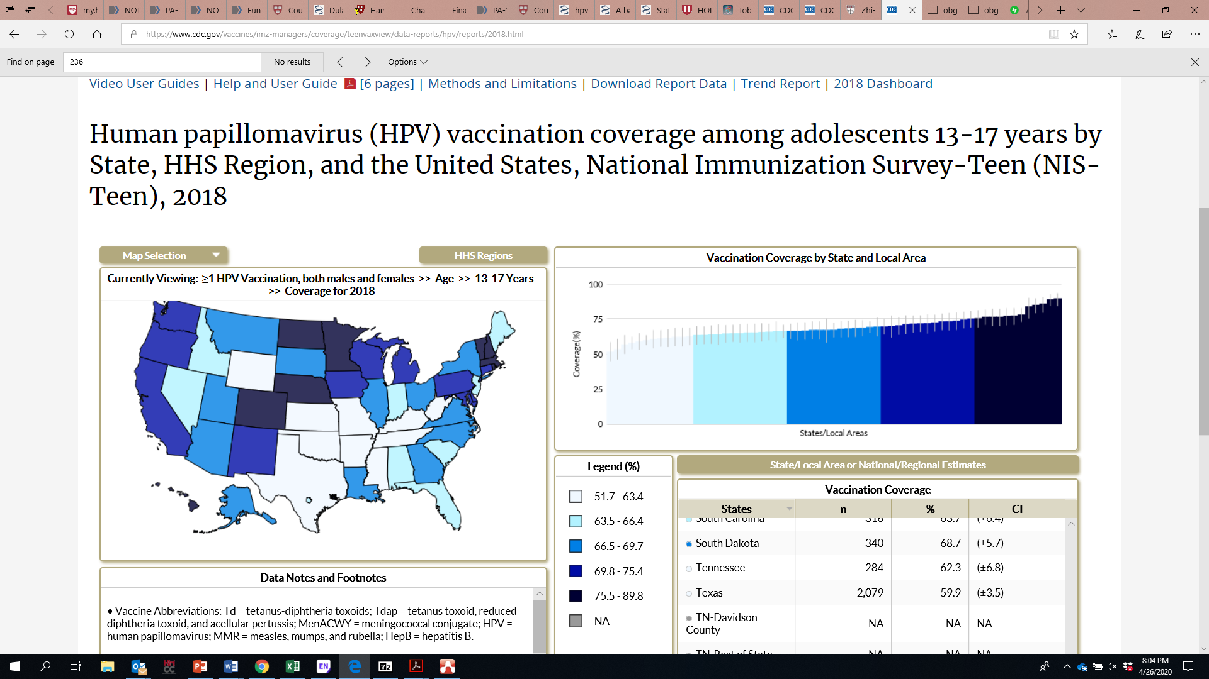

HPV Vaccination Rates in the US are Low
1+ Dose, HPV Vaccination 2018
Notes:
Map– lighter colors, lower vacc rates

Slide 38
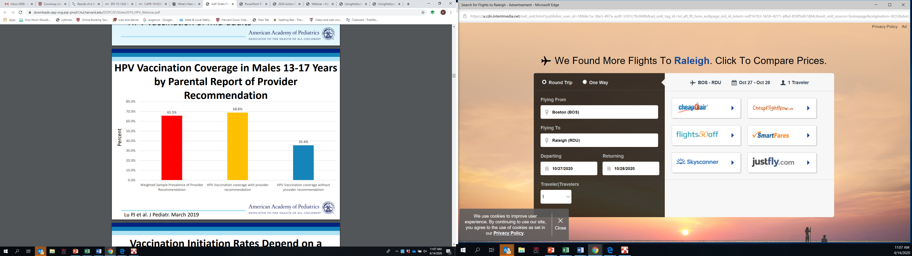
Provider Recommendation Has Big Impact on HPV Vaccination Rates (Males, 13-17)
HPV Vaccination Guidelines
Series complete - age 26
1st dose, 11–12 years
If 1st dose:
  < 15 years, 2 doses, 6 – 12 mos apart
  > 15 years, 3 doses within 6 mos
Notes:
Overall, high quality recommendation (same way, same day): 70-90% uptake
Low quality: 50%
No rec: 20-30%

Slide 39
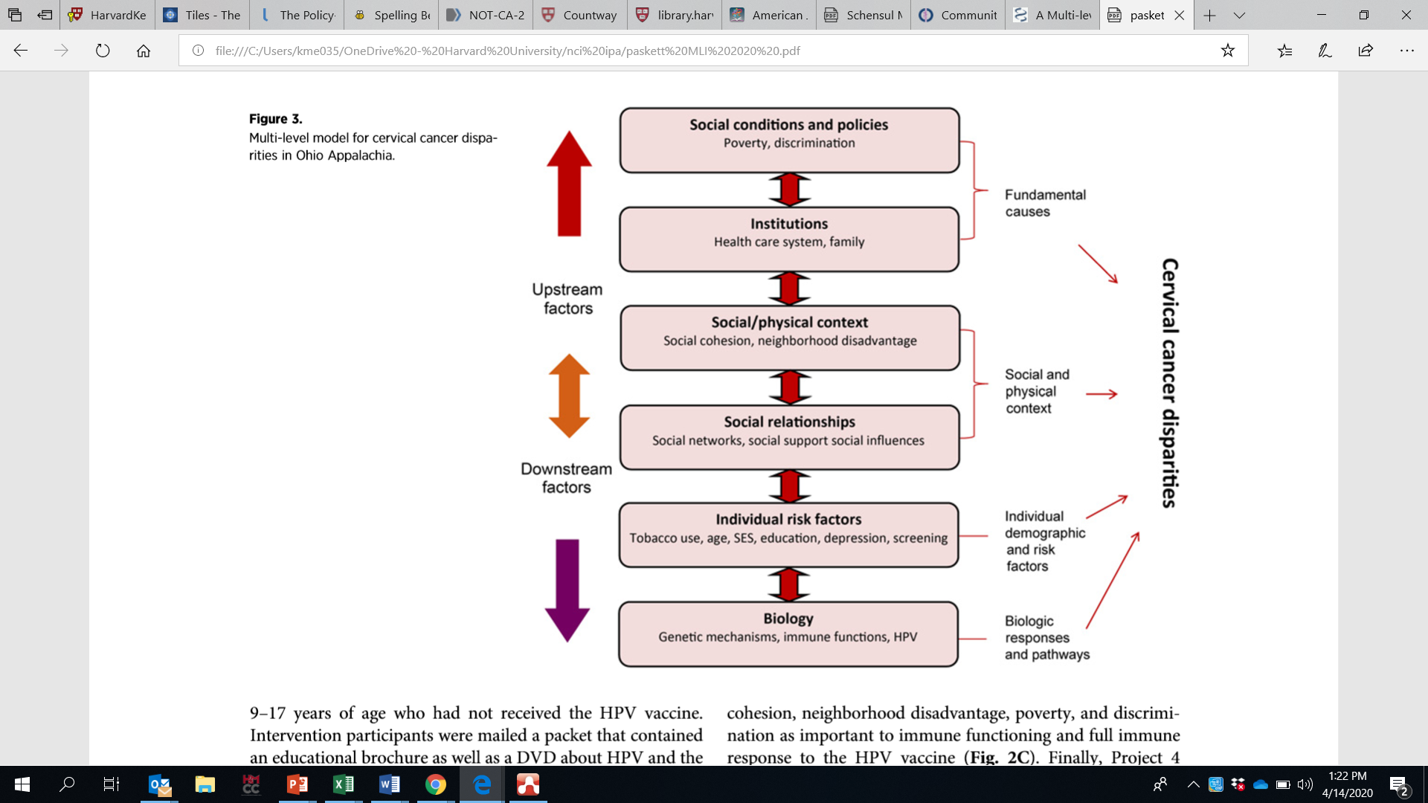
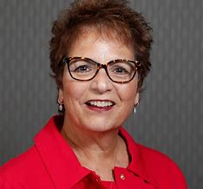
A Multilevel Model for HPV Vaccination & Cervical Cancer Disparities in Ohio Appalachia
Paskett, et al., 2020
Notes:
Cx disparities– same issues for HPV

Slide 40
The Parent Project– Intervention Targets and Components at Multiple Levels
Randomized by county (n=12)
HPV or flu vaccine intervention
CBPR process; Community Coalition partnership (Katz & Paskett, 2015)
Clinic-Level Intervention
“HPV environment”
Provider-Level Intervention
1-hour training
Educational materials
Parent Intervention
DVD & educational materials
Follow-up phone call
Theoretical Frameworks: Health Belief Model, Theory of Reasoned Action, Extended Parallel Process Model, Organizational Development Theory
Paskett, et al., 2020
Notes:
Clinic- created an environment where info on HPV was visible and readily available

Slide 41
The Parent Project
Recruitment across 12 counties
Full clinic participation: 22% (HPV); 26% (flu)
Provider enrollment: 99%
Post-survey: 96%
12-month survey: 80% (HPV); 74% (flu)
337 enrolled; recruitment rate not reported
Clinic-Level Intervention
“HPV environment”
Provider-Level Intervention
1-hour training
Educational materials
Parent Intervention
DVD & educational materials
Follow-up phone call
Paskett, et al., 2016
Notes:
Clinic- created an environment where info on HPV was visible and readily available

Slide 42
The Parent Project
What Were the Likely Implementation Challenges?
HIPAA limited ability to recruit parents from clinics
HPV approved only for girls at study start
Limited ability to impact at clinical level
Limited providing training time and frequency
What Were the Likely Evaluation Challenges?
11% (HPV), 18% (flu) of families received care from participating clinics
Limited ability to tease out differential effects of intervention levels
Clinic-Level Intervention
“HPV environment”
Provider-Level Intervention
1-hour training
Educational materials
Parent Intervention
DVD & educational materials
Follow-up phone call
Paskett, et al., 2016
Notes:
Limited ability to impact on clinical level– issue of large county-level evaluation, or more targeted implementation focused Ix

Slide 43
The Parent Project-Outcomes at
Multiple Levels
- Not measured
Knowledge increased significantly; no group differences
No change in self-efficacy re HPV discussions
13% HPV, 6.5% Flu arms had 1st HPV shot
71% HPV, 38% Flu arms had 2nd HPV shot
Clinic-Level Intervention
“HPV environment”
Provider-Level Intervention
1-hour training
Educational materials
Parent Intervention
DVD & educational materials
Follow-up phone call
Mediation analyses, process evaluation not reported
Paskett, et al., 2016
Notes:
Two issues: (1) linkage between parents and clinics; (2) limited connection to community

Slide 44
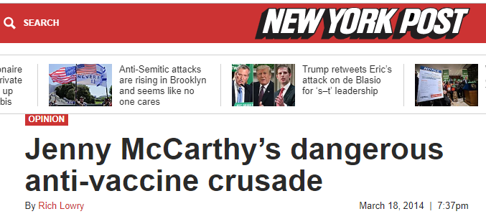
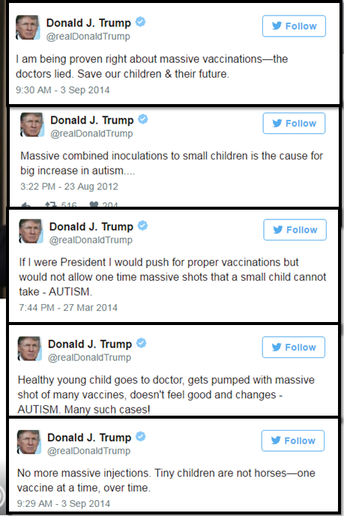
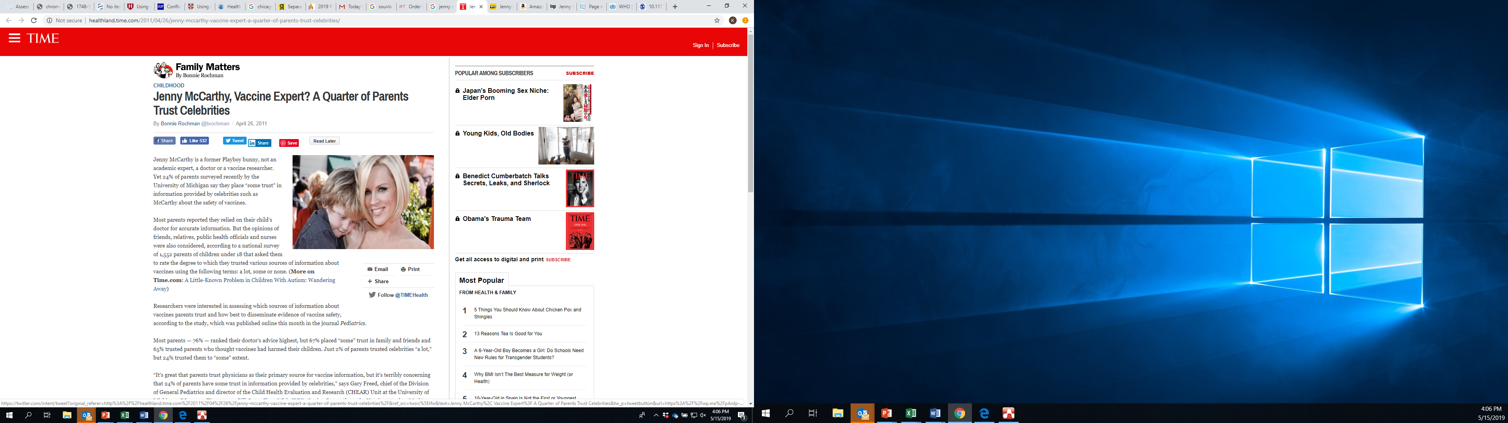
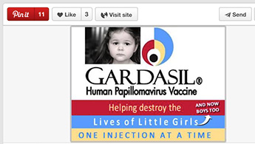
Emotional Contagion, Digitally Enabled
Notes:
The original Parent project had a plan to impact on community level through parental Ix at the clinic level. But wasn’t possible because of the disconnect between the clinic and the parental targets
But the “community” piece in HPV is really important; and it gets really tricky to think about how you define community in this case
The very effective use of social media by anti-vaccine groups has essentially created it’s own “community”, and allowed them to punch well above their weight in terms of size
And the PH community has not been so effective at pushing back on this– we rightly stand behind science but that’s not been proven to be an effective response in this environment (point to Gardasil ad)
Think about vaccine– really key question is what the right levels of Ix are.

Slide 45
Vaccine Refusal is Just One Part of the Complex Vaccination Problem
Delay in acceptance or refusal of vaccines, despite availability of vaccine services
Complex and context specific, varying across time, place, and vaccines
Need to lift up pro-vaccine community norms
Acceptance
Accept all vaccines
Accept but Doubts
Accept all vaccines
Accept but Doubts
Delay
Delay
Vaccine Refusers
Access
& Access
Barriers
In MA community health centers:
  47-59% of children complete all recommended early childhood vaccines
  30-49% of adolescents complete all recommended vaccines
McDonald NE and SAGE Working Groupon Vaccine Safety, Vaccine, 2015; 33(34):4161-4.
Notes:
Acceptance– even among those who accept, you can see doubts/delays;
Access Barriers– and then you also have access barriers– for HPV, not all states cover costs under VFC program; are also language, transportation, and other barriers that low income communities face

Slide 46

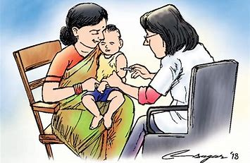
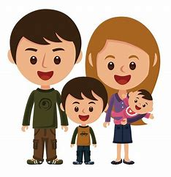
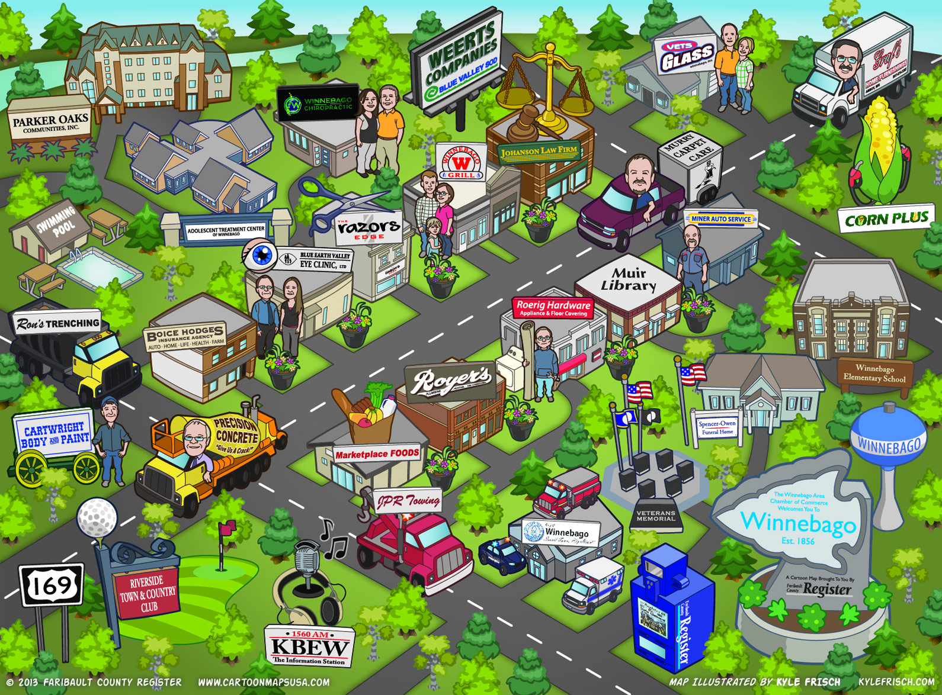
How Do You Pick Among These Levels?
Notes:
We decided not to pick!

Slide 47
We Vaccinate: A Multilevel Intervention to Increase Children’s Vaccination Uptake
Intervention Components by Intervention Level– CHC Selects 2 Strategies/Level
Parent | Provider | Health Care System | Coalitions/Partnerships
We Vaccinate materials in clinics Text reminders Access to resources to address social needs | Strong recommendation language, effective strategies to address parental concerns EHR vaccination module to track vaccination needs to each visit, reduce missed vacc opportunities Centralized audit feedback Discuss vaccination in prenatal care | We Vaccinate posters/materials in clinics Implement standard order sets & policy to allow medical assistants to vaccinate Use text reminders of upcoming vacc visits Proactive outreach to schedule vacc visits Proactive follow-up w/in one business day of missed appts to reschedule. Centralized audit feedback Offer walk-in/vaccine only visits Integrate vacc into social needs efforts | Toolkit for pro-vaccine social media and other communication activities We Vaccinate materials for use in schools and at community events Support for coalition activities
Implementation Support Team
Virtual Learning Community
What are the likely implementation challenges we will face?
Notes:
6 CHCs– all children’s vacc– early childhood and adolescent, including HPV (especially given low levels of overall vacc, and key to tying HPV to other vacc; and addressing overall community and system response to vaccine)
- Not yet funded

Slide 48
Thank You!
Notes:
IMHO, more levels, more likely impact
Highly complex
As Implementation Scientist, I tend to approach MLIs from an implementation frame– which means that I care a lot about setting context- within and outside of the system I am working with
Different ways to approach “community”

Slide 49

Case Study 2:
Multiple levels of influence on cervical cancer screening
Sandi Pruitt, Ph.D.
UT Southwestern Medical Center

Slide 50
Multiple levels of influence on cervical cancer screening
Sandi Pruitt
UT Southwestern Medical Center

Slide 51
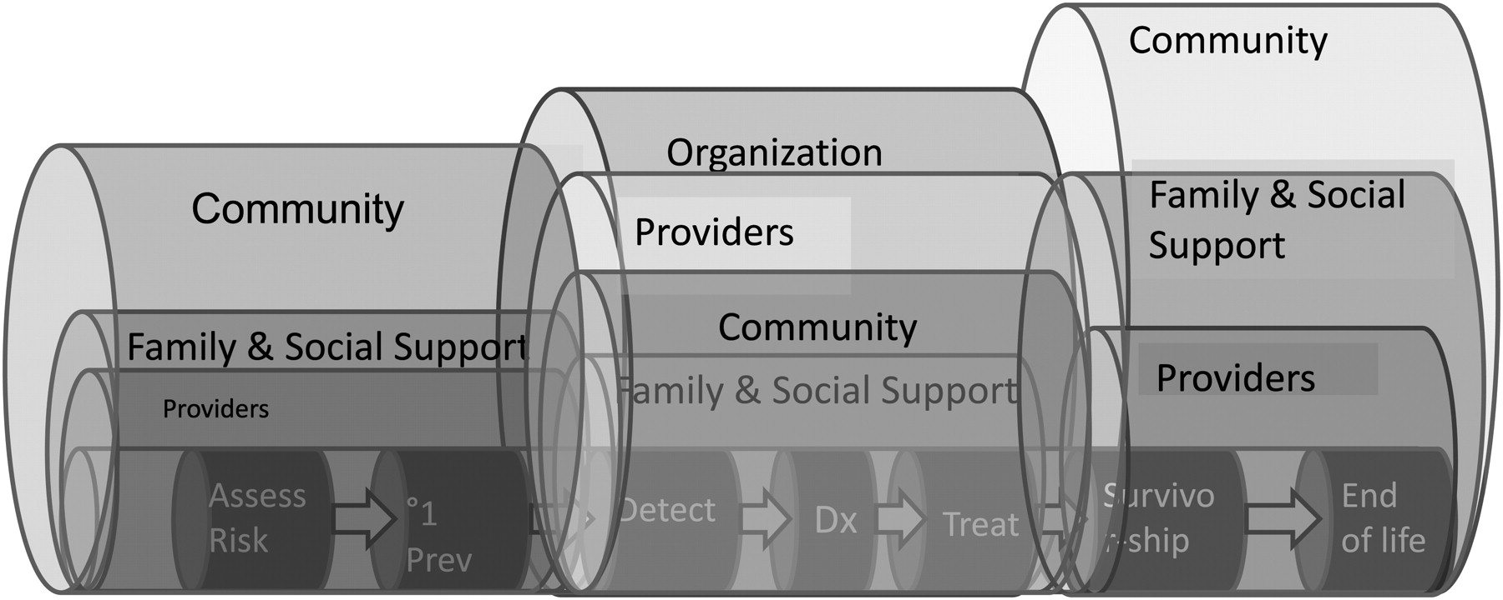

Contextual influences on cancer continuum
Taplin S H et al. J Natl Cancer Inst Monogr 2012;2012:2-10
© The Author 2012. Published by Oxford University Press.
Notes:
Providers
Physician recommendation contributes to Pap testing
(Coughlin et al, CEBP 2005)
Systems/clinics
“Computerized” reminders increase physician compliance with Pap testing (Litzelman et al JGIM 1993)
Clinic-based interventions like education for providers & patients, computer tracking can improve Pap screening (Paskett et al, Prev Med, 1998)
Neighborhoods
Residence in high poverty neighborhoods associated with nonrecent Pap screening (Datta et al, Cancer 2006)

Slide 52

Goal
To identify sources of multilevel variation in Pap screening that may be targets for intervention in 4 healthcare settings
Aim: Compare magnitude of variation across multiple levels (providers, clinics, neighborhoods) before and after adjustment for multilevel factors

Slide 53
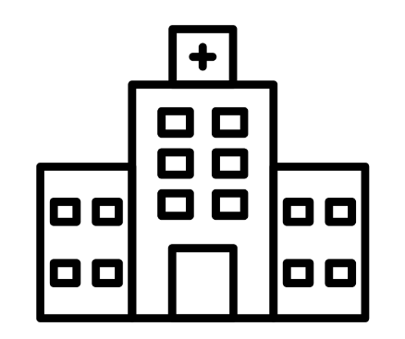

Why examine variation at multiple levels?
Clinic 1
50% patients screened
Clinic 2
50% patients screened
50% screened
No provider-level variation
50% screened
50% screened
Provider-level variation
15% screened
50% screened
85% screened
Doctor by Wilson Joseph, Map by hafiudin, Hospital by ibrandify, People by TS Graphics from the Noun Project
Notes:
Looking only at the average at one level can be misleading and can obscure variation at other levels. This might lead to unnecessary or less than optimal interventions.
Multilevel models provide evidence about disparity
Results can guide quality improvement and intervention efforts in new directions focused on equity.
***What if the providers each have a defined geographic catchment area and each provider sees patients from just 1 or 2 neighborhoods? After adjusting for clustering & potential cross-classification by neighborhood, provider-level differences may be attenuated or may emerge.
Cross-classification across levels, if not accounted for, can obscure disparities at some levels. This scenario shows variation at the neighborhood level &
indicates need for a different intervention
On the left, there is zero variation. On the right there is substantial variation

Slide 54
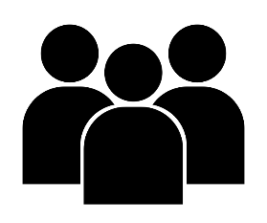

Typical Hierarchical Approach
Cross-classified Approach
Clinic 1
Neighborhood
Provider
Neighborhood 1
Clinic
Provider
Clinic 2
Neighborhood 2

Slide 55
Healthcare systems
 | Parkland | KP Washington | Mass General Brigham Health System
Region | Dallas County, TX | Washington State | Eastern MA
System type | Integrated safety-net healthcare system with 1 hospital and outpatient clinics (primary care, women’s health, and specialty) | Mixed-model managed care system with diverse insurance plans, a large integrated group practice | Two PCP networks with the Mass General Brigham (MGB) Health System 1. MGB: Mass General Brigham Health 2. BWH: Brigham and Women’s Hospital

Slide 56
Eligibility
Average risk, age-eligible for screening, due for Pap screening at cohort entry
Known neighborhood (census tract) of residence
Cohort entry at time of first PCP/ob-gyn visit during 2010-2017

Slide 57
Methods
EPIC® EHR linked to American Community Survey at census tract level
Nest patients within 3 levels
  Provider, clinic, and neighborhood of residence, defined at cohort entry visit
Outcome: Time (in days) to Pap screen after cohort entry and before end of 5-year outcome ascertainment window
Patients censored at age 66, dis-enrollment, moved out of catchment, death, had cervical procedure (e.g., biopsy, treatment, etc.)

Slide 58
Cross-classified regression
Bayesian approach
  Estimate variance while accounting for cross-classification
Accelerated failure time (AFT) model
  Random effects of neighborhood, provider and clinic
  Assume normal random error
Why AFT vs. Cox survival model?
  AFT directly assesses variability in event time (on log scale)
    In survival models, variability is specified on hazard scale

Slide 59
Estimating multilevel variation
Empty model
  Include only the random effects to identify the variation at each level
Full model
  Include patient-level covariates and group-level covariates in addition to the random effects
Best-fitting model
  Expected log pointwise predictive density (ELPD) to identify best-fitting model
    i.e., to identify what random effects to include; this model included all covariates from the full model
Notes:
For example, provider A only treated one patient, hence there is no variation in getting patients a Pap test for this provider. In the meanwhile, provider B treated 100 patients and 35 of them got a Pap test.
Better interpretability of variance.
An AFT model is also a type of survival model. It is just not as widely used as the Cox PH model in medical research. In addition to the point you mentioned, advantages of an AFT model include but may be not limit to:
Better interpretation of results, as it is more similar to a traditional regression setting.
AFT models provide a wide range of shapes of hazed function, such as the one we used in this project (the lognormal distribution).
The log-linear formulation in AFT models emphasizes that the roles of regression parameters (coefficients) and dispersion parameters (variance in random effects) are clearly separated.
Regression parameter estimates (although not of great interest in our case) are robust to neglected covariates.
In survival models, the random effects are specified on the scale of hazard (hazard by itself is a quite abstract concept), which is not easy to interpret.
In AFT model, as you can see from the equation that the random effects directly assess the variability in event time (on the log scale).

Slide 60
Multilevel covariates
Patient level
Age
Race/ethnicity (NH White, NH Black, NH Asian, Hispanic, other/multiple)
Year of cohort entry
BMI
Number of comorbidities
PCP/Ob-gyn visit in year before cohort entry
Smoking status (current, former, never)
Pregnant during 5-year ascertainment period
Provider level
  Type (MD/DO, PA, NP)
  Specialty (general internal med, family med, ob-gyn, oncology)
Clinic/facility level
  Type (hospital, clinic, FQHC, mobile)
Neighborhood level
  Urban/rural
  Census tract percent poverty, percent college educated, percent Black, & percent Hispanic

Slide 61
Patient characteristics (N=280,039)
 | KPWA N=104,006 | Parkland N=92,297 | BWH N=41,922 | MGH N=41,814
Median age (IQR) | 41 (29-53) | 46 (35-55) | 39 (28-52) | 37 (28-52)
 | % | % | % | %
Race/ethnicity
Hispanic | 6 | 47 | 11 | 7
Black | 5 | 32 | 10 | 6
White | 63 | 15 | 67 | 74
Asian | 12 | 5 | 6 | 9

Slide 62
Multilevel characteristics
 | KPWA | Parkland | BWH | MGH
Most common provider specialty | MD- family med | MD: family med | MD- gen internal | MD- gen internal
Neighborhood Median % Poverty | 10 (7-17) | 23 (15-32) | 8 (4-16) | 10 (5-17)

Slide 63
Time (in days) to Pap screening
Sites | % Pap <5 years | Median days
Parkland | 40 | 188
KPWA | 44 | 189
Partners-Brigham | 42 | 301
Partners-MGH | 39 | 273

Slide 65
Parkland
Point estimates=variance parameter; larger number=greater variance; whiskers= 95% credible interval.
Notes:
Multiple levels influence Pap screening
More variation between facilities, followed by clinics, and neighborhoods
Except at Partners-MGH, where providers may have greater discretion in practice
Variation not completely explained by covariates
Of all health systems, KPWA has least variation
Automatic “birthday letters” sent to eligible women
Other differences in clinic or system practices to be assessed
Impact of organized vs. opportunistic screening

Slide 66
Next Steps
We need multilevel interventions to reduce facility-level, provider-level variation
    Organized screening outreach, systems approaches
    What characteristics at facility level increase / decrease timely screening?
    What characteristics at facility level increase / reduce variation?
We need to use cross-classified models to evaluate intervention impacts
  Do our interventions increase or decrease variation?

Slide 67
Acknowledgements
UT Southwestern Medical Center
Song Zhang (Project co-lead)
Eric Borton
Amy E. Hughes
Danyi Xiong
Celette Sugg Skinner
Kaiser Permanente Washington Health Research Institute
Aruna Kamineni
Jessica Chubak
Al Derus
Harvard
Jennifer S. Haas
David Cheng
National Cancer Institute
Sarah Kobrin
All PROSPR METRICS co-investigators & staff
National Cancer Institute UM1CA221940
  MPIs:
  Jasmin Tiro
  Jennifer Haas
  Aruna Kamineni
  Celette Sugg Skinner
  Images
  From Noun Project (Doctor by Wilson Joseph, Map by hafiudin, Hospital by ibrandify, People by TS Graphics)

Slide 68
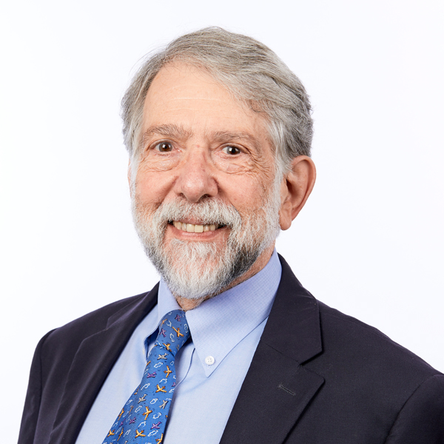
Case Study 3:
Exemplary Case Studies of MLI Research
Martin Charns, Ph.D.
Boston University

Slide 69
VA Lean Multi-Level Intervention
Alignment Across the Organization
Integration across Internal Boundaries
Leadership Commitment to Quality
Informed Decision Making
Use of Experts (Sensei)
Impetus to Transform
Improvement Initiatives
Organization
Service/VS
Staff Engagement
Individual
Veteran Engagement
Capability Development
Multi
Staffing
Organization Culture
Communication

Slide 70
Key Points
Many interventions to implement QI or Lean focus on improvement projects & individual skills
People wonder why few are highly successful & sustained
They are not attending to the many other factors at other levels
This is true for most complex interventions, whether specifically QI or not
Many implementation articles reporting on limited success include in their Discussion how organizational factors negatively affected their implementation

Slide 71

Discussant 1:
Observations on the case studies and how theory was employed
Gregory Aarons, Ph.D.
University of California
San Diego

Slide 72
Discussant 2:
Observations on the designs, methods, and evaluation approaches employed in the case studies
Brian S. Mittman Ph.D.
Kaiser Permanente

Slide 73
Desired features of MLI research
Intervention/Study Feature | Multilevel Intervention Studies
Study aims | Assess intervention effectiveness; document mechanisms of effect
Primary outcomes | Multiple outcomes at two, three or more levels
Intervention targets | Multiple target groups
Intervention content | Multiple, multilevel intervention activities
Explicit causal model | Required
Explicit use of theory | Required, combining multiple theories, models, and/or frameworks that capture influence at multiple levels and interactions between levels
Distinguish core functions from forms; identify functions | Strongly recommended; required for PCORI funding applications
Intervention tailoring | Preferable to permit and study
Study design | Clustered, adaptative, other atypical designs often needed
Analysis of contextual influences | Recommended unless effects are not context-sensitive
Process evaluation and explicit study of mediators and mechanisms of effect | Strongly recommended; mandatory if intervention is not highly robust
Qualitative study of mechanisms of effect | Strongly recommended
Quantitative study of mechanisms of effect (e.g., mediation analysis) | Strongly recommended
Other applications of qualitative/mixed methods | Strongly recommended

Slide 74
Questions and Answers
1:50pm - 2:00pm

Slide 75
Introduction to MLTI Advanced Learning
Erica S. Breslau, Ph.D.
National Cancer Institute

Slide 76


MLTI Curriculum Objectives
Review the state-of-science on the study of multilevel research methods and interventions within and across diverse healthcare settings.
Broaden the conceptualization of multilevel science by examining the relationship among intervention design, measures, implementation, effectiveness and observed health outcomes for individuals.
Strengthen knowledge of multilevel science within the scientific community.

Slide 77
Cores of MLI
Research
Measurement
Analysis
Theory
Research
Question

Slide 78

Course Modules
January 20, 2022-June 23, 2022
1
2
3
4
5
6
7
8
Introduction
Small
Group
Small
Group
Small
Group
Theory in
Intervention
Design
Quantitative Analytic Techniques
Quantitative Analytic Techniques
Use &
Role of
Theory
9
10
11
12
13
14
15
16
Small
Group
Quantitative Analytic Techniques
Small
Group
Qualitative & Mixed Methods
Small
Group
Qualitative & Mixed Methods
Small
Group
Measures
&
Measurement
17
18
19
20
21
22
23
Small
Group
Putting
it all Together
Small
Group
Special
Topics
In MLI
Small
Group
Capstone
Presentations
Capstone
Presentations

Slide 79
Training Expectations
1.
2.
3.
Attendance
Assignments
Collaboration
Questions
Participate
Respond
Use chat function
Post assignments/slides
Respond
Required
Small Group
Confluence
  Post response to questions at the end of each module, AND respond to a post one of your small group members

Slide 80
Deliverables
Module 3
Elevator pitch describing your project
(5-minutes)
Ongoing
Small group assignments
(Weekly)
Modules
22 &23
Capstone Project:
Slides & Presentation (5-minutes)
Specific aims (2-3 pages)
Modules
1, 22 &2 3
Evaluation
(Pre and Post Survey)

Slide 81
Thank you

Slide 82
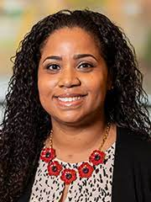
Pre-MLTI Evaluation
2:10-2:20pm
Jennifer McGee-Avila, Ph.D., M.P.H.
National Cancer Institute

Slide 83
Break
2:20pm - 2:30pm

Slide 84

Plenary:
Delivery of MLIs in Public Health
Hal Yee, M.D., Ph.D.
Los Angeles County Department of Health Services

Slide 85
Questions and Answers
Wrap-up
2:50-2:55pm

Slide 86
Module 2
Thursday, January 27, 2021
(Pre-recorded: 120 minutes)

